Slide 1
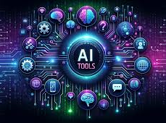

Slide 2

ChatSpot is an AI-powered assistant developed by HubSpot.
It helps users manage CRM(Customer Relationship Management) tasks
like sales, marketing, and customer support using simple chat commands.
With ChatSpot, users can get data, create reports, send emails, and update
contacts easily without technical knowledge
Example:
Sales Team Example A sales manager types: 👉 “Show me this month’s best-performing sales rep”
ChatSpot instantly displays the report from HubSpot CRM

Slide 3
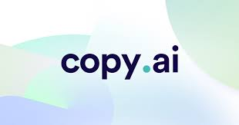
Copy.ai is an AI-powered writing tool that helps users create marketing
content like ads, emails, blogs, and social media posts.
It saves time by generating high-quality content quickly using simple prompts.
Example:
A small business owner types: 👉 “Write a catchy Instagram caption for my store’s sale”
Copy.ai instantly generates a ready-to-use promotional caption.

Slide 4

Fireflies.ai is an AI-powered meeting assistant that records, transcribes,
and summarizes online meetings automatically, helping teams
save time and track important discussions.
Example:
A team member joins an online meeting. 👉 Fireflies.ai automatically records the meeting, transcribes the
discussion, and highlights key points and action items.

Slide 5

Revind AI is an AI-powered platform that helps manufacturers optimize
production, manage workflows, and improve efficiency using data-driven
insights.
Cyber security: Protecting computers, networks, and data from attacks
or unauthorized access.
Example:
Revind AI uses encryption and secure access controls to keep client data
safe from hackers.

Slide 6
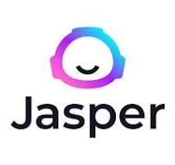
Jasper AI is an AI-powered content creation tool used mainly by
marketers and businesses to write blogs, advertisements, emails, and
social media content faster, while maintaining a consistent brand voice
and quality.
Example : A digital marketer types: 👉 “Write a catchy Instagram caption for a new clothing brand launch” Jasper AI instantly generates engaging captions with hashtags,
saving time and effort.

Slide 7
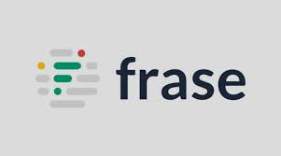
Frase.io is an AI-powered content tool that helps writers research topics,
create SEO-friendly content, and answer user questions faster.
Example:
A blogger uses Frase.io to analyze top Google results and write a well-optimized
article in minutes.

Slide 8

DALL·E 3 is an advanced AI image generation tool that creates detailed,
high-quality visuals from simple text prompts, helping users turn ideas into
images quickly.
Example:
A marketer enters “a cozy café in rainy weather” and DALL·E 3 generates a
professional image for an ad or post.

Slide 9
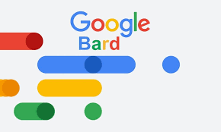
Google Bard is an AI chatbot by Google that helps users find information,
answer questions, and generate content using conversational AI.
Example:
A student asks Google Bard to explain a science topic, and it provides a
simple, easy-to-understand explanation.

Slide 10

Clara is an AI-powered virtual assistant that helps schedule meetings by
handling emails and coordinating calendars automatically.
Example:
A manager asks Clara to set up a meeting, and Clara emails participants,
finds a suitable time, and confirms the schedule.

Slide 11

Pictory is an AI-powered video creation tool that turns text, blogs, or scripts into professional-looking videos with visuals, captions, and music—without video editing skills.
Example:
A marketer converts a written article into a promotional video using
Pictory for Instagram or YouTube.

Slide 12

Plus AI is an AI-powered presentation tool that helps create professional
slides quickly by generating content and layouts automatically.
Example:
A student enters a topic, and Plus AI instantly creates a well-designed
presentation.

Slide 13

ChatGPT is an advanced AI chatbot that understands and generates
human-like text. It can answer questions, provide explanations, create
content, and assist with tasks like writing, coding, or learning.
Example:
A professional asks ChatGPT to draft an email, summarize a report, or
generate ideas for a project, saving time and effort.

Slide 14
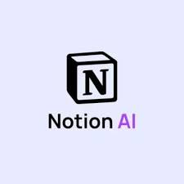
Notion is a versatile productivity and collaboration platform that combines
note-taking, task management, databases, and project planning in a single
workspace. It helps individuals and teams stay organized, manage
workflows, and collaborate efficiently.
Example:
A startup team uses Notion to plan projects, track tasks, store documents,
and share updates with everyone in one place.

Slide 15

Motion is an AI-powered productivity tool that automates task and calendar
management to help users plan their day efficiently.
Example:
A professional uses Motion to automatically schedule tasks around meetings,
ensuring everything gets done on time.

Slide 16

Murf AI is an AI voice generation tool that converts text into realistic,
natural-sounding speech for videos, presentations, or podcasts.
Example:
A content creator types a script, and Murf AI turns it into a professional
voiceover without recording audio manually.

Slide 17
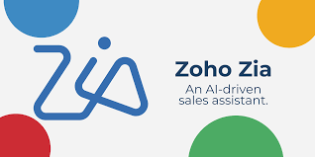
Zoho Zia is an AI assistant integrated into Zoho’s apps that helps with
sales, customer support, and analytics by providing insights, predictions,
and automation.
Example:
A sales manager asks Zoho Zia to identify the most promising leads,
and it suggests actions to increase conversions.

Slide 18
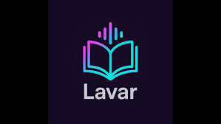
Lavar is an interactive, voice‑first AI reading platform that makes books
and learning materials talk back to you — you can ask questions,
get explanations, and explore content conversationally as if the material
were a guide or tutor. It uses voice AI and adaptive dialogue to enhance
reading engagement and personalized learning.
Example:
A student listens to a textbook on Lavar and asks “Explain this chapter,”
and the platform responds with clear answers and insights.
If you meant another Lavar product (like an app or business), let me know!

Slide 19
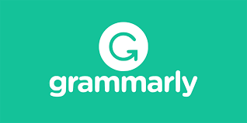
Grammarly is an AI-powered writing assistant that checks grammar,
spelling, punctuation, and style, and suggests improvements for clear and
professional writing.
Example:
A student uses Grammarly to proofread an essay and fix errors before
submitting it.

Slide 20

Techopedia is an online platform that provides clear definitions,
explanations, and articles about technology, IT concepts, and digital trends.
Example:
A student looks up “cloud computing” on Techopedia to understand it in
simple, easy-to-grasp terms.

Slide 21
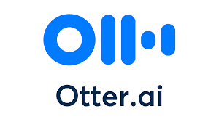
Otter.ai is an AI-powered transcription and note‑taking tool that listens to
conversations (like meetings or lectures) and turns them into accurate,
searchable text notes.
Example:
During a team meeting, Otter.ai records the discussion and provides a
written transcript with key highlights and speaker labels.

